Slide 1
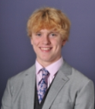
Eco-Committee Members
Name: Theo Pritchard
Year Group: Year 13
Why I have chosen to be on the eco committee:
I am the Eco Prefect within the sixth form Senior Prefect Team. I therefore take a lead role within the Eco Committee to ensure that we make progress with our environmental initiatives.

Slide 2
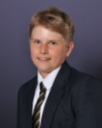
Eco-Committee Members
Name: Aaron Powell
Year Group: Year 11
Why I have chosen to be on the eco committee:
I am very dedicated to the environment and I take many steps in my own life to help the environment. I would like to help make the school more environmentally friendly and I enjoy working in a team with others.

Slide 3
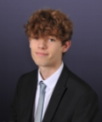
Eco-Committee Members
Name: Robin Winterbourne
Year Group: Year 12
Why I have chosen to be on the eco committee:
I would like to become a member of the eco-committee because I believe environmentalism isn't talked about enough or taken as seriously as it should be. I think I am a good choice because I'm passionate about our environment and want to make a difference.

Slide 4
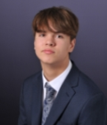
Eco-Committee Members
Name: Finley Dawson
Year Group: Year 12
Why I have chosen to be on the eco committee:
I would like to be a member of the school's Eco-Committee as I am incredibly passionate about improving the quality of the environment and the reduction of litter across the school. I was previously in the green group for organising the Green day which was only cancelled due to the lockdown.

Slide 5
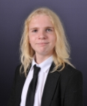
Eco-Committee Members
Name: Snorri Tomasson
Year Group: Year 12
Why I have chosen to be on the eco committee:
I am rather aware of the current state of the environment and would rather help improve it than sit and watch it get worse.

Slide 6
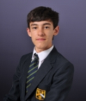
Eco-Committee Members
Name: Taylor Abrook
Year Group: Year 10
Why I have chosen to be on the eco committee:
Since, I learnt about Climate Change, I knew that I had to help stop it as it will ruin millions of lives. It's only logical isn't it. I was quite shocked about how people knew it existed, yet still decided to make poor choices. I want to help put a stop to this globe affecting hazard. I would be good because I am honest, caring and definitely not boring.

Slide 7
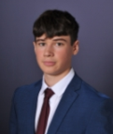
Eco-Committee Members
Name: Toby Cranko Mills
Year Group: Year 13
Why I have chosen to be on the eco committee:
I am an enthusiast of the environment and want to do my part in trying to live a more sustainable lifestyle in order to protect the planet. I hope to study geography at university and so believe this would be a good role to help progress my application, whilst teaching me some valuable skills and letting me express my passion.

Slide 8
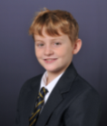
Eco-Committee Members
Name: Teddy Laing
Year Group: Year 9
Why I have chosen to be on the eco committee:
I would like to join the school Eco-committee as it is beneficial to the environment, school and me as it teaches important values. I think I would be a good choice as I have many ideas and I am good at rationalizing.

Slide 9
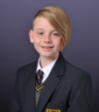
Eco-Committee Members
Name: Cathal Elders
Year Group: Year 7
Why I have chosen to be on the eco committee:
I would like to make a change in the amount of co2 entering our atmosphere and I would like to do it through our school.

Slide 10
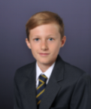
Eco-Committee Members
Name: George Hardy
Year Group: Year 9
Why I have chosen to be on the eco committee:
I would like to join as I think that more needs to be done to ensure the safety of our planets future and the future of our children and grandchildren.

Slide 11
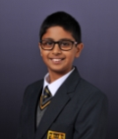
Eco-Committee Members
Name: Iyaadh Mohamed
Year Group: Year 7
Why I have chosen to be on the eco committee:
I would like to be a member of the school's Eco committee because I am passionate about doing something to help stop the climate crisis and want to make a difference by using this opportunity. I think that I will make a good choice as I can cooperate with other's well, propose innovative ideas, am resilient and creative and can complete a project to a high standard within a set time limit.

Slide 12
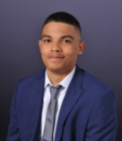
Eco-Committee Members
Name: Jayden Barrett
Year Group: Year 12
Why I have chosen to be on the eco committee:

