Slide 1
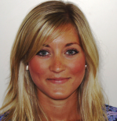
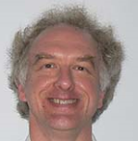
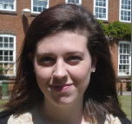
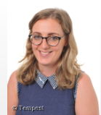
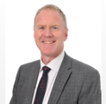
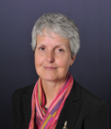
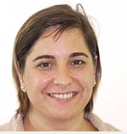
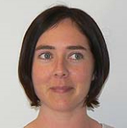
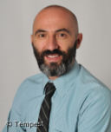
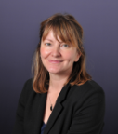
Staff Ambassadors
Mrs Freeman
Sustainability Lead
Mr Newham
History Department
Mrs Graham
Head of Social Sciences
Miss Pickton
Second in Social Sciences
Mr Patterson
Maths Department
Mrs Del Rio-Burns
MFL Department
Mrs Waller
English Department
Mr Rombout
History Department
Mrs Allen
Food Tech Department
Mrs Robertson
English Department

